Slide 1
Computer Graphics: 3D – Projections
Tommy Marrinan, PhD

Slide 2
Mathematics of Projections
Simplest cases
Parallel projection
DOP is the z-axis
View-plane z=0 plane
Perspective projection
PRP at origin
View-plane parallel to XY-plane

Slide 3


Mathematics of Projections
Parallel – ignore z
$x_{p}=x$
$y_{p}=y$
$z_{p}=0$
$M_{par}=\left[\begin{matrix}\begin{matrix}\begin{matrix}1 & 0 & \begin{matrix}0 & 0\end{matrix}\end{matrix} \\ \begin{matrix}0 & \begin{matrix}1 & 0 & 0\end{matrix}\end{matrix} \\ \begin{matrix}0 & \begin{matrix}0 & 0 & 0\end{matrix}\end{matrix}\end{matrix} \\ \begin{matrix}0 & \begin{matrix}0 & 0 & 1\end{matrix}\end{matrix}\end{matrix}\right]$

Slide 4
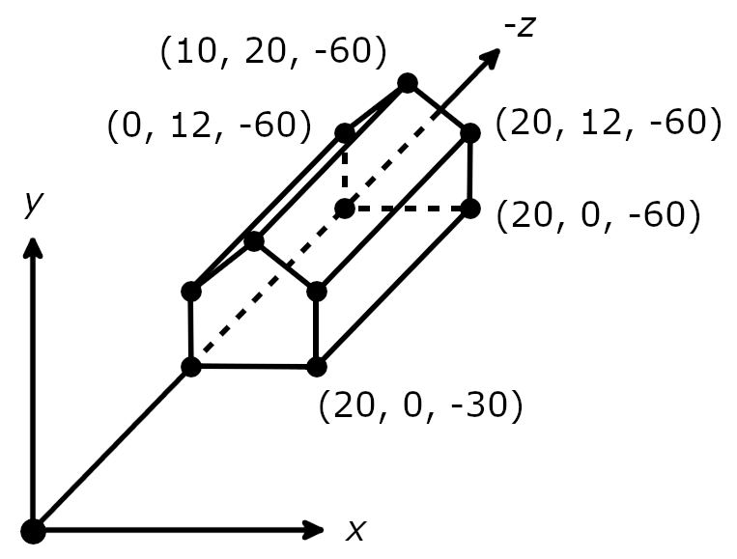

Mathematics of Projections
Example
PRP: (10, 10, 5)
SRP: (10, 10, -30)
VUP: (0, 1, 0) Near,Far: [5, 100] Left,Right: [-11, 11]
Bottom,Top: [-11, 11]
$$M_{par}=\left[\begin{matrix}\begin{matrix}\begin{matrix}1 & 0 & \begin{matrix}0 & 0\end{matrix}\end{matrix} \\ \begin{matrix}0 & \begin{matrix}1 & 0 & 0\end{matrix}\end{matrix} \\ \begin{matrix}0 & \begin{matrix}0 & 0 & 0\end{matrix}\end{matrix}\end{matrix} \\ \begin{matrix}0 & \begin{matrix}0 & 0 & 1\end{matrix}\end{matrix}\end{matrix}\right]$$

Slide 5
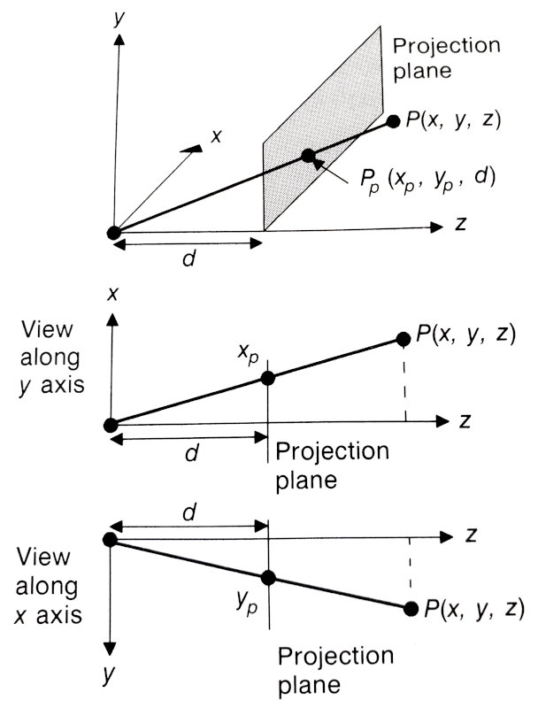

Mathematics of Projections
Perspective - similar triangles
$\frac{x_{p}}{d}=\frac{x}{z}$
$\frac{y_{p}}{d}=\frac{y}{z}$
$x_{p}=\frac{d⋅x}{z}=\frac{x}{z/d}$
$y_{p}=\frac{d⋅y}{z}=\frac{y}{z/d}$

Slide 6
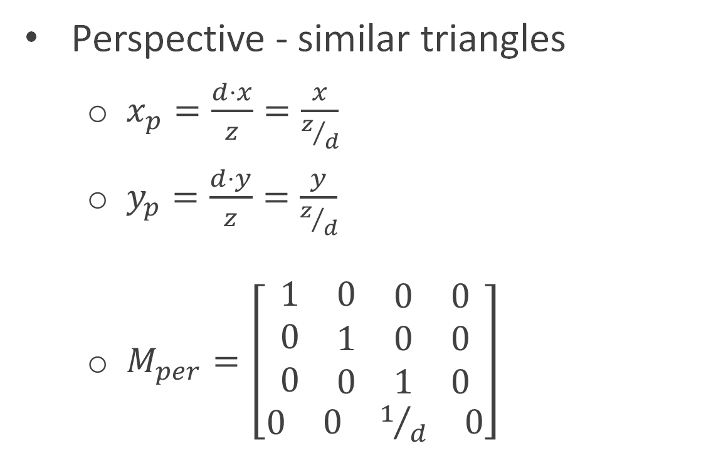
Mathematics of Projections
Perspective - similar triangles
$x_{p}=\frac{d⋅x}{z}=\frac{x}{z/d}$
$y_{p}=\frac{d⋅y}{z}=\frac{y}{z/d}$
$M_{per}=\left[\begin{matrix}\begin{matrix}\begin{matrix}1 & 0 & \begin{matrix}0 & 0\end{matrix}\end{matrix} \\ \begin{matrix}0 & \begin{matrix}1 & 0 & 0\end{matrix}\end{matrix} \\ \begin{matrix}0 & \begin{matrix}0 & 1 & 0\end{matrix}\end{matrix}\end{matrix} \\ \begin{matrix}0 & \begin{matrix}0 & 1/d & 0\end{matrix}\end{matrix}\end{matrix}\right]$

Slide 7
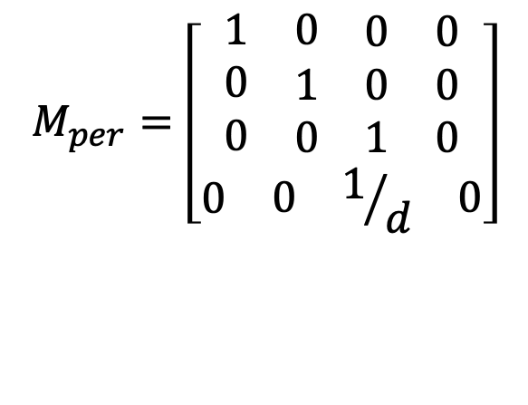
Mathematics of Projections
Example
PRP: (0, 0, 0)
SRP: (0, 0, -30)
VUP: (0, 1, 0) Near,Far: [30, 100] Left,Right: [-1, 21]
Bottom,Top: [-1, 21]
$$M_{per}=\left[\begin{matrix}\begin{matrix}\begin{matrix}1 & 0 & \begin{matrix}0 & 0\end{matrix}\end{matrix} \\ \begin{matrix}0 & \begin{matrix}1 & 0 & 0\end{matrix}\end{matrix} \\ \begin{matrix}0 & \begin{matrix}0 & 1 & 0\end{matrix}\end{matrix}\end{matrix} \\ \begin{matrix}0 & \begin{matrix}0 & 1/d & 0\end{matrix}\end{matrix}\end{matrix}\right]$$

Slide 8
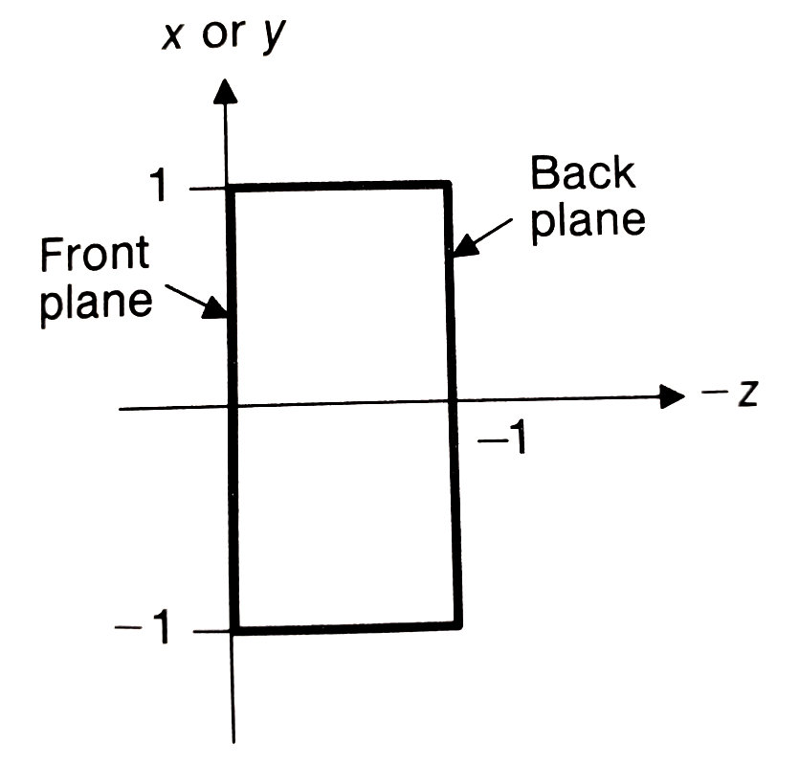
Mathematics of Projections
General cases
Parallel projection
Translate PRP to origin
Rotate VRC such that (u,v,n) align with (x,y,z)
Shear such that CW is on the z-axis
Translate near clipping plane to origin
Scale such that view volume bounds are ([-1,1], [-1,1], [-1,0])

Slide 9

General Parallel Projection
Translate PRP to origin
$T\left(−PRP\right)=\left[\begin{matrix}1 & 0 & 0 & {−PRP}_{x} \\ 0 & 1 & 0 & {−PRP}_{y} \\ 0 & 0 & 1 & {−PRP}_{z} \\ 0 & 0 & 0 & 1\end{matrix}\right]$

Slide 10

General Parallel Projection
Rotate VRC such that (u,v,n) align with (x,y,z)
$R=\left[\begin{matrix}u_{1} & u_{2} & u_{3} & 0 \\ v_{1} & v_{2} & v_{3} & 0 \\ n_{1} & n_{2} & n_{3} & 0 \\ 0 & 0 & 0 & 1\end{matrix}\right]$

Slide 11
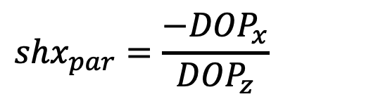

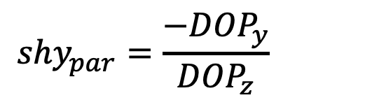
General Parallel Projection
Shear such that CW is on the z-axis
${SH}_{par}=\left[\begin{matrix}1 & 0 & {shx}_{par} & 0 \\ 0 & 1 & {shy}_{par} & 0 \\ 0 & 0 & 1 & 0 \\ 0 & 0 & 0 & 1\end{matrix}\right]$
$${shx}_{par}=\frac{{−DOP}_{x}}{{DOP}_{z}}$$
$${shy}_{par}=\frac{{−DOP}_{y}}{{DOP}_{z}}$$

Slide 12

General Parallel Projection
Translate front clipping plane to origin
$T_{par}=\left[\begin{matrix}1 & 0 & 0 & 0 \\ 0 & 1 & 0 & 0 \\ 0 & 0 & 1 & near \\ 0 & 0 & 0 & 1\end{matrix}\right]$

Slide 13
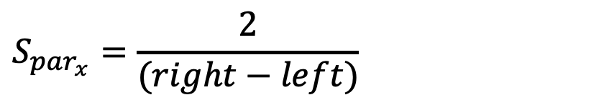

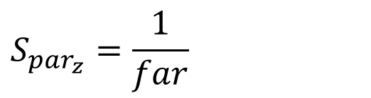
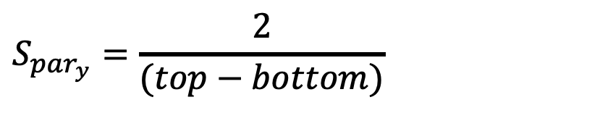
General Parallel Projection
Scale such that view volume bounds are ([-1,1], [-1,1], [-1,0])
$S_{par}=\left[\begin{matrix}S_{{par}_{x}} & 0 & 0 & 0 \\ 0 & S_{{par}_{y}} & 0 & 0 \\ 0 & 0 & S_{{par}_{z}} & 0 \\ 0 & 0 & 0 & 1\end{matrix}\right]$
$$S_{{par}_{x}}=\frac{2}{(right−left)}$$
$$S_{{par}_{y}}=\frac{2}{(top−bottom)}$$
$$S_{{par}_{z}}=\frac{1}{far}$$

Slide 14
General Perspective Projection
Clip against canonical view frustum
Left: x = -1, Right: x = 1
Bottom: y = -1, Top: y = 1
Front: z = 0, Back: z = -1

Slide 15

General Parallel Projection
Put it all together
$N_{par}=S_{par}⋅T_{par}⋅{SH}_{par}⋅R⋅T\left(−PRP\right)$
Clip
$M_{par}$
Projection
View

Slide 16
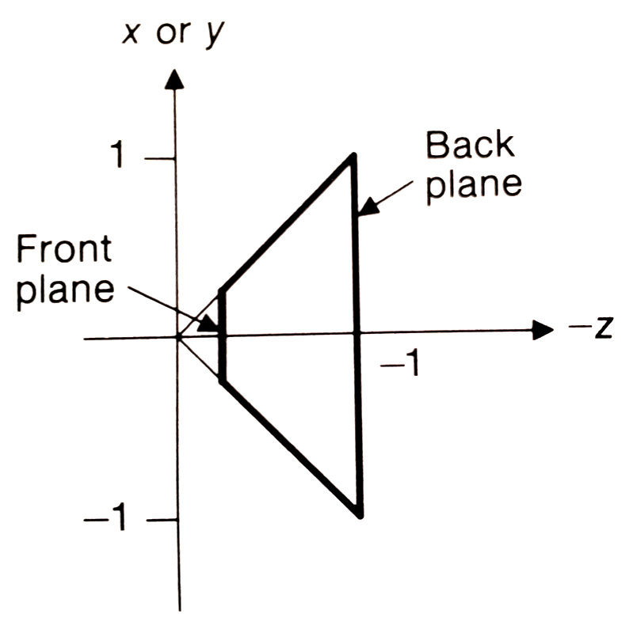
Mathematics of Projections
General cases
Perspective projection
Translate PRP to origin
Rotate VRC such that (u,v,n) align with (x,y,z)
Shear such that CW is on the z-axis
Scale such left plane is x=z, right plane is x=-z, bottom plane is y=z, top plane is y=-z, and back plane is z=-1

Slide 17
General Perspective Projection
Translate PRP to origin
$T\left(−PRP\right)=\left[\begin{matrix}1 & 0 & 0 & {−PRP}_{x} \\ 0 & 1 & 0 & {−PRP}_{y} \\ 0 & 0 & 1 & {−PRP}_{z} \\ 0 & 0 & 0 & 1\end{matrix}\right]$

Slide 18
General Perspective Projection
Rotate VRC such that (u,v,n) align with (x,y,z)
$R=\left[\begin{matrix}u_{1} & u_{2} & u_{3} & 0 \\ v_{1} & v_{2} & v_{3} & 0 \\ n_{1} & n_{2} & n_{3} & 0 \\ 0 & 0 & 0 & 1\end{matrix}\right]$

Slide 19
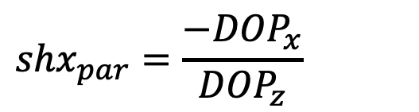

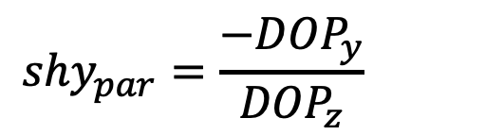
General Parallel Projection
Shear such that CW is on the z-axis
${SH}_{par}=\left[\begin{matrix}1 & 0 & {shx}_{par} & 0 \\ 0 & 1 & {shy}_{par} & 0 \\ 0 & 0 & 1 & 0 \\ 0 & 0 & 0 & 1\end{matrix}\right]$
$${shx}_{par}=\frac{{−DOP}_{x}}{{DOP}_{z}}$$
$${shy}_{par}=\frac{{−DOP}_{y}}{{DOP}_{z}}$$

Slide 20
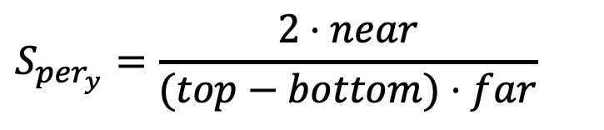
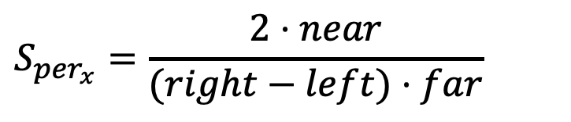

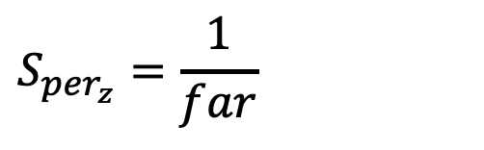
General Perspective Projection
Scale such left plane is x=z, right plane is x=-z, bottom plane is y=z, top plane is y=-z, and back plane is z=-1
$$S_{per}=\left[\begin{matrix}S_{{per}_{x}} & 0 & 0 & 0 \\ 0 & S_{{per}_{y}} & 0 & 0 \\ 0 & 0 & S_{{per}_{z}} & 0 \\ 0 & 0 & 0 & 1\end{matrix}\right]$$
$$S_{{per}_{x}}=\frac{2⋅near}{(right−left)⋅far}$$
$$S_{{per}_{y}}=\frac{2⋅near}{(top−bottom)⋅far}$$
$$S_{{per}_{z}}=\frac{1}{far}$$

Slide 21
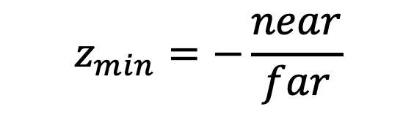
General Perspective Projection
Clip against canonical view frustum
Left: x = z, Right: x = -z
Bottom: y = z, Top: y = -z
Front: z = z_{min}, Back: z = -1
$$z_{min}=−\frac{near}{far}$$

Slide 22

General Perspective Projection
Project to back
d = -1
$M_{per}=\left[\begin{matrix}\begin{matrix}\begin{matrix}1 & 0 & \begin{matrix}0 & 0\end{matrix}\end{matrix} \\ \begin{matrix}0 & \begin{matrix}1 & 0 & 0\end{matrix}\end{matrix} \\ \begin{matrix}0 & \begin{matrix}0 & 1 & 0\end{matrix}\end{matrix}\end{matrix} \\ \begin{matrix}0 & \begin{matrix}0 & −1 & 0\end{matrix}\end{matrix}\end{matrix}\right]$

Slide 23

General Perspective Projection
Put it all together
$N_{per}=S_{per}⋅{SH}_{par}∙R⋅T\left(−PRP\right)$
Clip
$M_{per}$
Projection
View

Slide 24
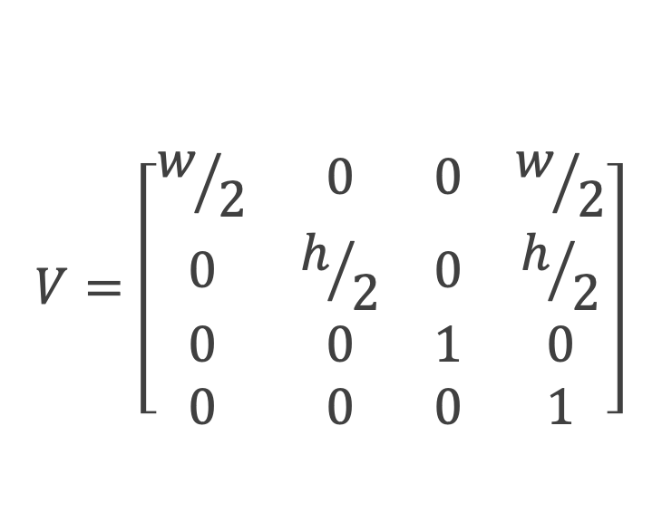
Projection to Window
After performing projections on the canonical view volume, models have x and y vertices in range [-1, 1]
Must transform them to window/framebuffer units
Translate (1,1): make new range [0, 2]
Scale (width/2, height/2): make new range
x [0, width]
y [0, height]
$$V=\left[\begin{matrix}w/2 & 0 & 0 & w/2 \\ 0 & h/2 & 0 & h/2 \\ 0 & 0 & 1 & 0 \\ 0 & 0 & 0 & 1\end{matrix}\right]$$

